Slide 1

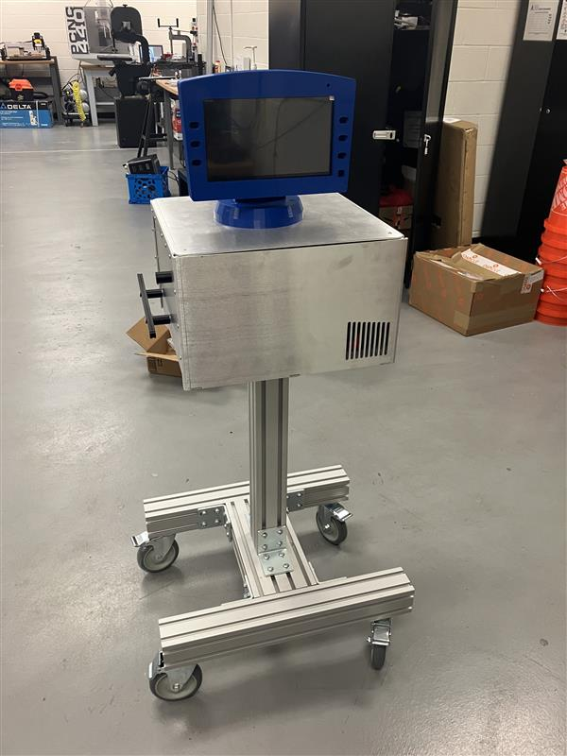
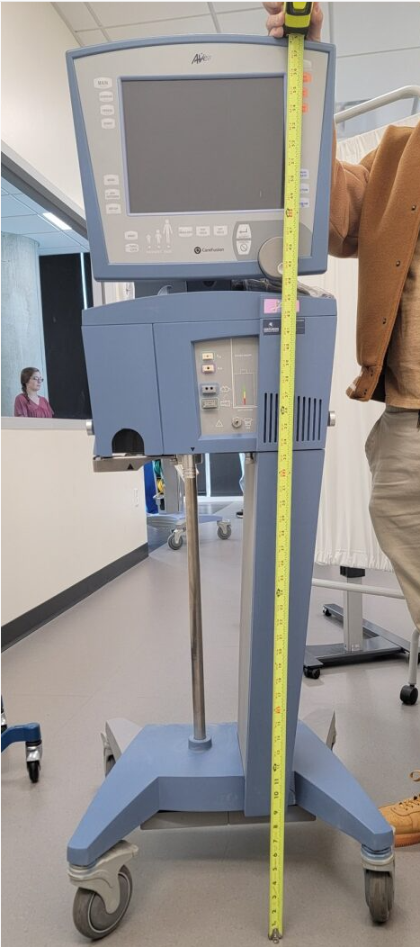
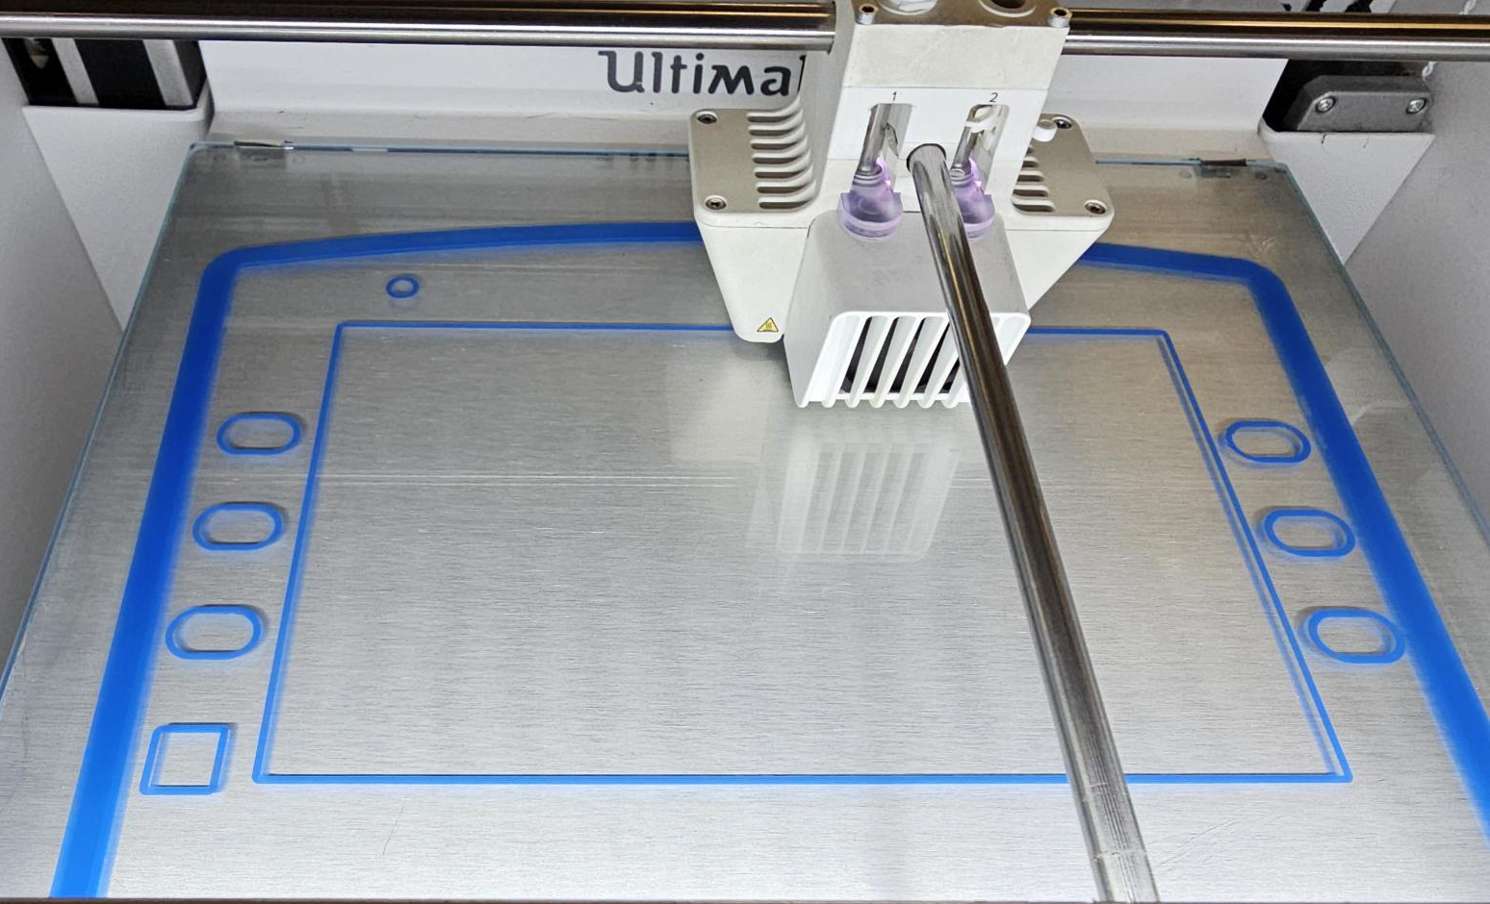
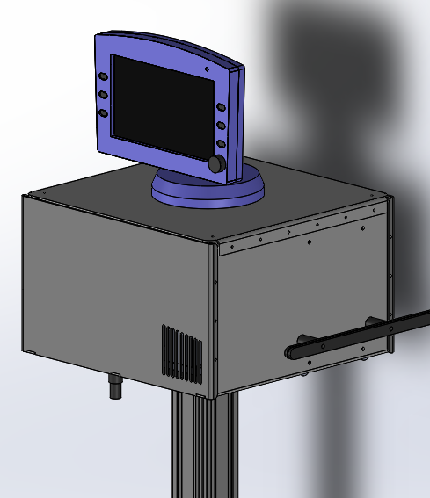
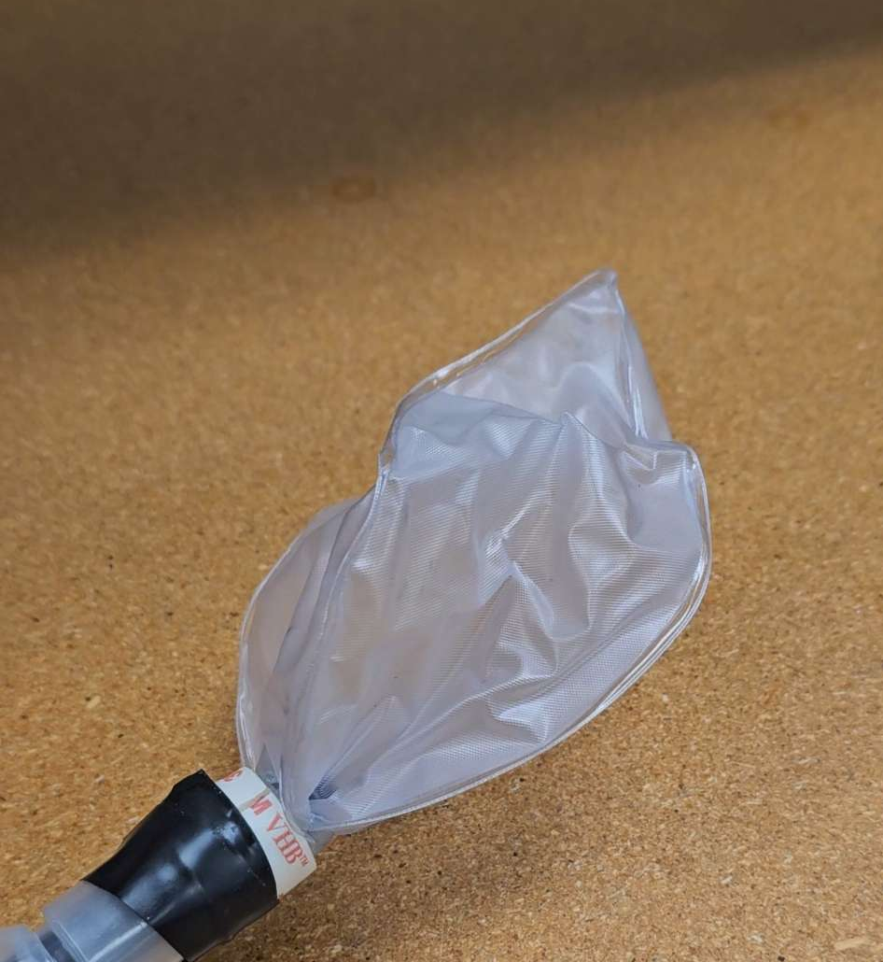
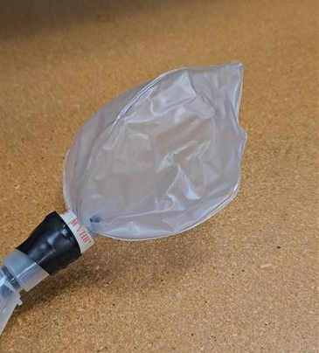
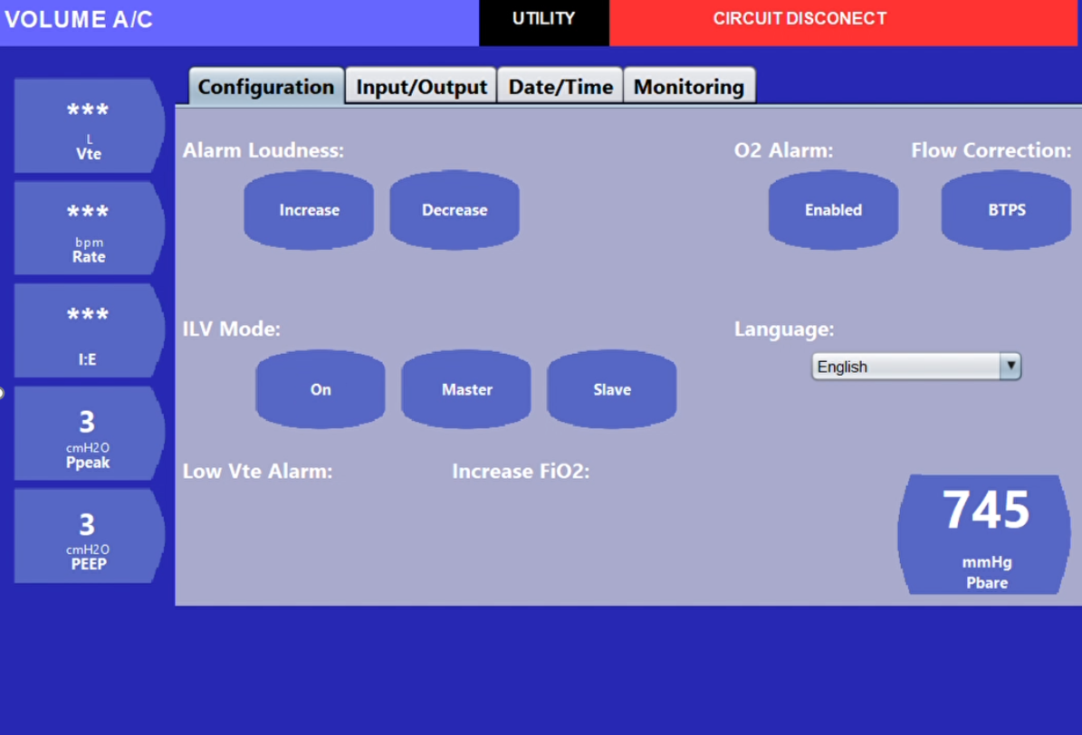
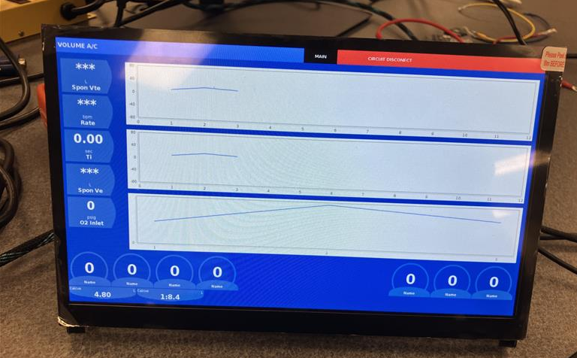
Breathe Easy Sim
Gomez, D., Harris, E., Henry, K., Sprinkle, E., Zayas, M.
Sponsors: Dr. Shawn Gieser, Erica Hinojosa
CSE Senior Design
Executive Summary
Simulation Ventilator Design
Results of Simulation Ventilator
The UTA SMART Hospital provides simulation environments designed to give nursing students realistic operating experiences in a hospital-like setting. This includes using real hospital equipment, such as an AVEA ventilator, on smart manikin patients. However, equipment such as the AVEA ventilator are not designed for manikin use, causing the internal bladders that allow the manikins to "breathe" to rupture when used. To alleviate this problem, we have created the Breath Easy Sim to provide reduced and controlled airflow capability so as not to rupture the manikin's air bladder. Additionally, the Breathe Easy Sim is equipped with simulation software to provide as close an operating experience as possible to a real medical environment. Other features such as alarms, control dials, buttons, and health diagnostic outputs are also simulated to heighten the medical training experience.
The appearance of the Breathe Easy Sim was designed to closely resemble that of a real medical ventilator, complete with touchscreen, control dials, alarms, locking casters, and tubing hookups. The main body of ventilator is made of aluminum sheet metal attached to an extruded aluminum base. The design was intended to provide the user with a lightweight product that is easy to transport and install, while maintaining durability in a hospital environment.
The interior pump mechanism provides controlled positive and negative air pressure to the manikin that can be easily adjusted to the manikin's bladder size (patent applied for).
The software environment was created to provide a realistic simulation of ventilator software, featuring patient diagnostic information, adjustable ventilator settings, and alarm notification. The software is integrated with an embedded controller to monitor the health of the pump mechanism and seamlessly interfaces with the touchscreen monitor.
Modular and lightweight design provides ease of transportation and on-site installation.
95% of the interior pump mechanism is 3D printed, supplying the user with quick replacement of parts.
Customizable software and airflow settings can be set for variety of ventilator and manikin brands.
Conclusions
Figure 1. Manikin Bladders
The Breathe Easy Sim met our sponsor's design requests for simulation appearance and functionality.
Future design ideas include backup battery support in the event of power outages, as well as the inclusion of additional sensors to further enhance the simulation environment.
Thank you to Professor McMurrough and Dr. Geiser for design support.
Thank you to Steve Lopez for help with 3D printing and MakerSpace access.
Thank you to Erica Hinajosa for support and guidance.
Background
Figure 3. Breath Easy Sim versus AVEA Medical Ventilator
Out of the several medical simulation devices that are available on the market for training and education, there are currently no simulators that provide similar functionality to a medical ventilator. Our objective was to create a simulation ventilator that provided the user with as close an experience as possible to the real ventilators used by UTA's SMART Hospital, while still maintaining the integrity of the manikin bladders. It is imperative for student's training experience that the look, feel, and use of the Breathe Easy Sim is a realistic as possible so that the experience can be easily transferred to a medical ventilator in field.
References
Andres L. Mora Carpio and Jorge I. Mora. Positive end-expiratory pressure. https://www.ncbi.nlm.nih.gov/books/NBK441904/, 2023.
IngMar Medical. Make your simman and simboy ventilator ready. https://www.ingmarmed.com/wp-content/uploads/2019/10/Lung-Solution-9-19.pdf, 2019. Accessed: 09/21/2023.
Laerdal Medical. Asl 5000 breathing simulator - ingmar medical. https://www.ingmarmed.com/product/asl-5000-breathing-simulator/, 2022. Accessed: 09/12/2023.
Lardal Medical. Simman 3g plus | parts. https://laerdal.com/us/doc/4516/SimMan-3G- Plus/Webshop/PARTS.
Lardal Medical. Asl 5000 lung solution live virtual product demo. https://www.youtube.com/watch?v=zFVX6YT2qeg, 2020.
Figure 2. Simulated Software Running on Touchscreen
Figure 4. Screenshot of Software Menu

